Slide 1
Concentrated Solar Power
Parag Vyas, 18.10.2024

Slide 2
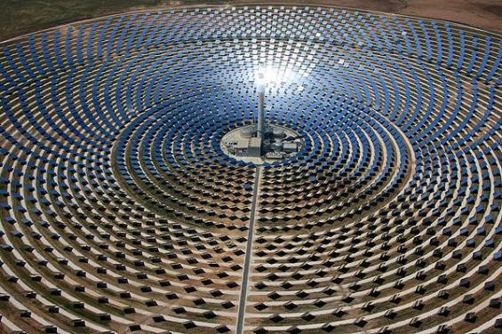
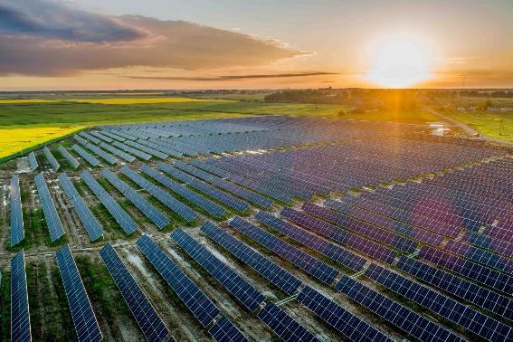
Concentrated Solar Power (CSP)
Solar Photovoltaics (PV)
https://www.renewable-technology.com/projects/gemasolar-concentrated-solar-power-seville/attachment/gemasolar-concentrated-solar-power-seville1/
https://ceenergynews.com/renewables/polands-largest-pv-farm-gets-financing-from-three-banks/

Slide 3
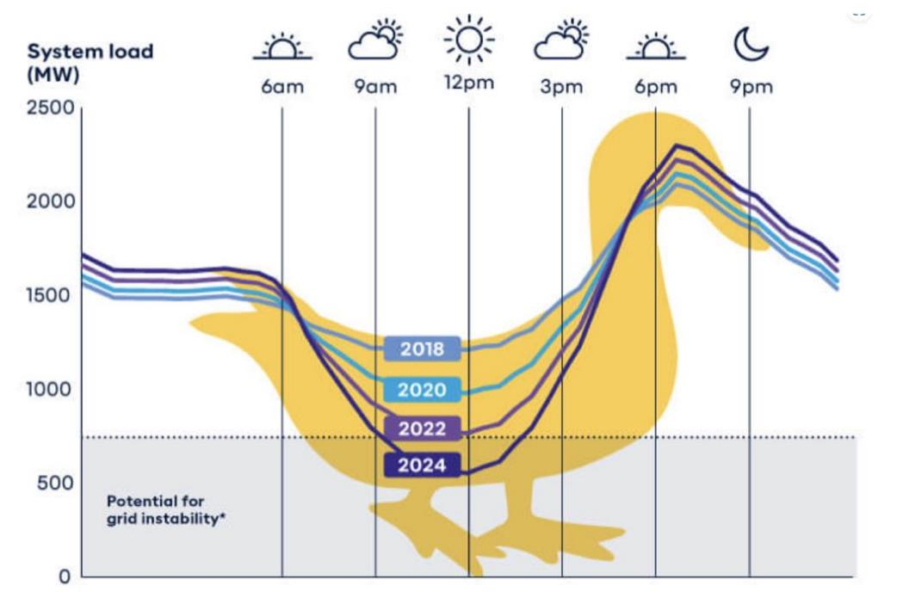
https://reneweconomy.com.au/wa-to-use-solar-duck-to-give-free-power-to-states-households-doing-it-tough/

Slide 4
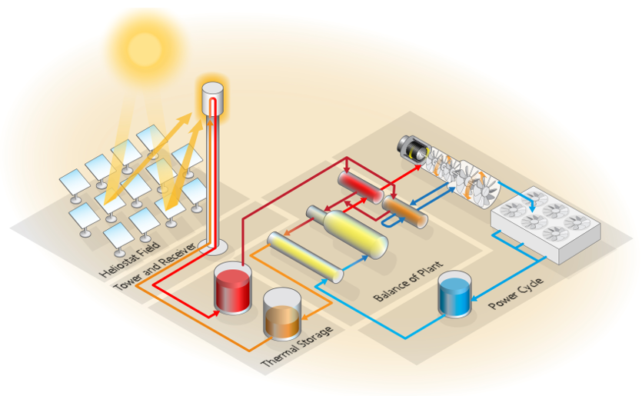
Concentrated Solar Power Plant Layout
Image: System Advisor Model, National Renewable Energy Laboratory

