Slide 1
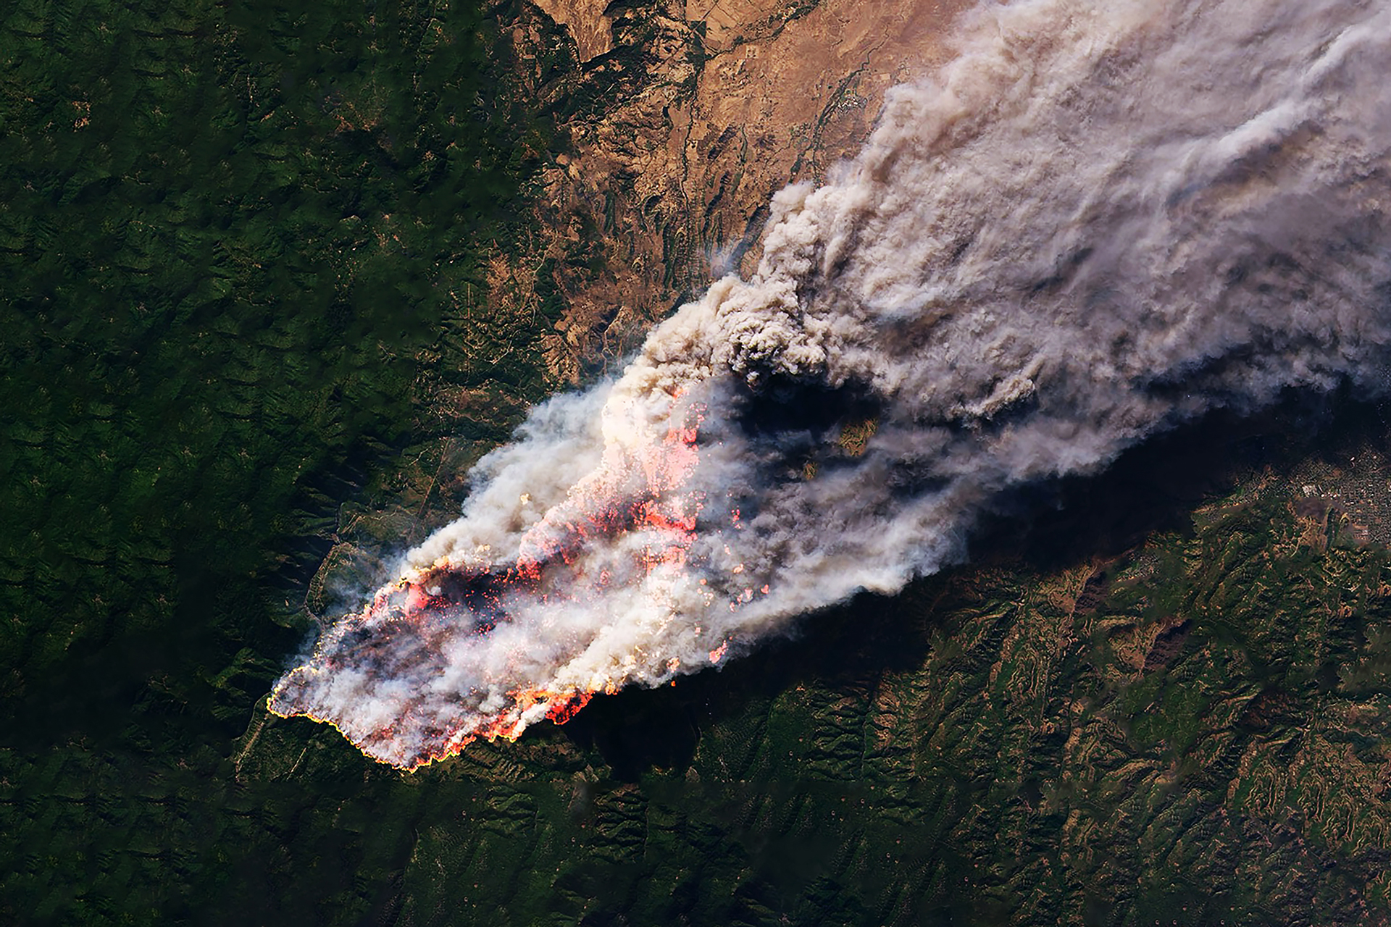


Session for the unteamed and next steps
June 2026

Slide 2
Next steps
1 Book a short exit interview with Mai, Jack, Marina or Simon or complete exit form
Reflect on your journey
Share next steps
Engagement with Carbon13 moving forward
2 Share a short update in Slack to let your peers know
They can reflect on their own teaming considerations
Make sure you have connected on LinkedIn
3 Complete the feedback form
It will be shared on Slack today (it takes only 5min)

Slide 3
Practical things
1 Platform + Slack access
You will have access to the platform until Friday, Jul 17th
You will continue to be part of the Slack channel
2 Peer support
Apply to be a DE
Part of brain trusts

Slide 4
Few options
1 Reverse Pitch – Carbon13 Startups Present Their Open Roles!
Tuesday, June 30, 16:30 GMT (17:30 CEST)
2 Rejoin programme
You will go through the application process again
Applications open now; kick-off at end of September
3 Check out Carbon13’s Jobs Board
https://carbonthirteen.com/careers/

Slide 5
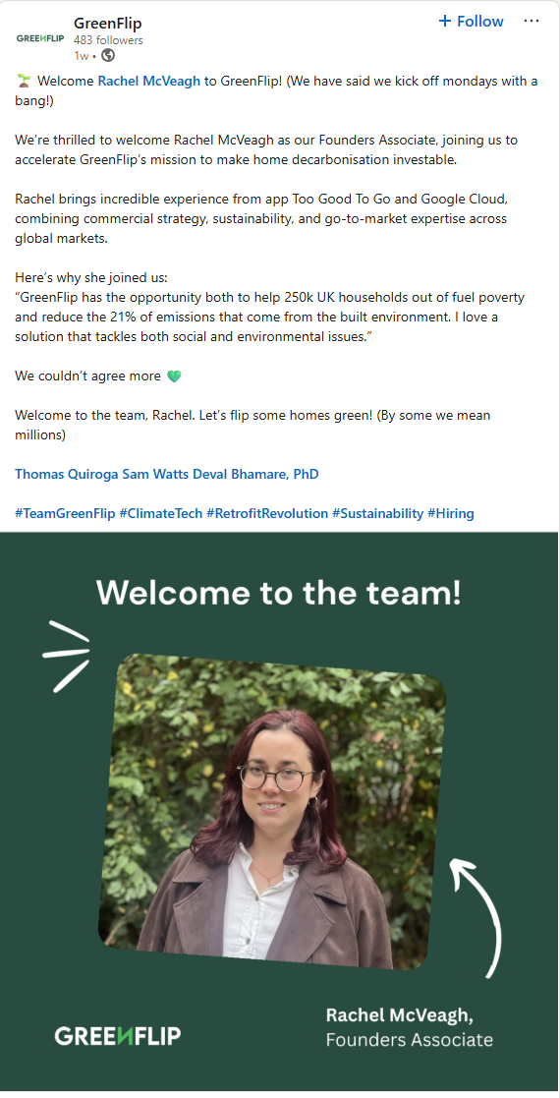
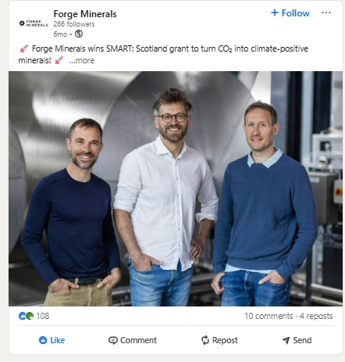
Life is full of surprises!

Slide 6
Q&A

